Slide 1
Online Book Store Management System
RNS INSTITUTE OF TECHNOLOGY
BENGALURU - 98
DEPARTMENT OF INFORMATION SCIENCE & ENGINEERING
Presentation on DBMS Mini Project Work
Subramanya Rao Shodhan Shetty
1RN20IS163 1RN20IS149
Date: 19/01/2023
Time: 11:30
Guide
Mr. Santosh Kumar
Prof. Dept of ISE, RNSIT
Lab in Charge
Dr. R Rajkumar
Associate Professor, Dept. of ISE, RNSIT

Slide 2
AGENDA
Abstract
Introduction
Front end and Back end tools
ER-Diagram
ER to Schema Mapping
Schema Diagram
Tables description with Normalization
Stored Procedures and Triggers
Results
Snapshots
Applications
Conclusion
References

Slide 3
ABSTRACT
The purpose of Online Book Store is to automate the existing manual system
Online Book Store, can lead to error free, secure, reliable and fast management system.
It can assist the user to concentrate on their other activities rather to concentrate on the record keeping.
Thus it will help organization in better utilization of resources.
The organization can maintain computerized records without redundant entries.
That means that one need not be distracted by information that is not relevant, while being able to reach the information.

Slide 4
INTRODUCTION
The "Online Book Store" has been developed to override the problems prevailing in the practicing manual system.
This software is supported to eliminate and in some cases reduce the hardships faced by this existing system.
Moreover this system is designed for the particular need of the company to carry out operations in a smooth and effective manner.
The application is reduced as much as possible to avoid errors while entering the data.

Slide 5
LITERATURE SURVEY
The spectrum used for the review of literature focuses upon the definition of an event, quality and difficulty to manage an event.
An event can be described as a public assembly for the purpose of celebration, education, marketing or reunion. Events can be classified on the basis of their size, type and context. An event can be a social / lifecycle event like a birthday party, engagement, wedding, funeral etc. or an education and career event like an education fair, job fair, workshop, seminar, debate, contest, competition etc. [3]. Quality in terms of event management can be described as the degree of excellence of an event [4]. The quality of service provided is dependent upon many parameters which should answer the question “Is this good enough?”

Slide 6
Requirements
SOFTWARE REQUIREMENTS
Operating System: Windows 10 or higher
Database: SQLite
Tools WSGI Server or higher
HARDWARE REQUIREMENTS
Processor: Any Processor above 500 MHz
RAM: 4.00GB or above
Hard Disk: 512GB
Compact Disk: 700Mb
Input device Keyboard
Output device: Laptop Display Screen, or any Display

Slide 7
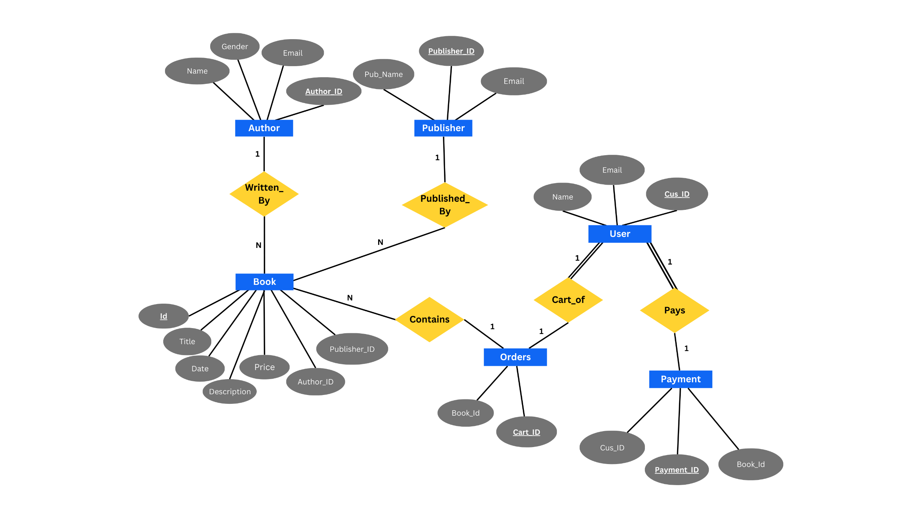
System Design
ER Diagram…

Slide 8
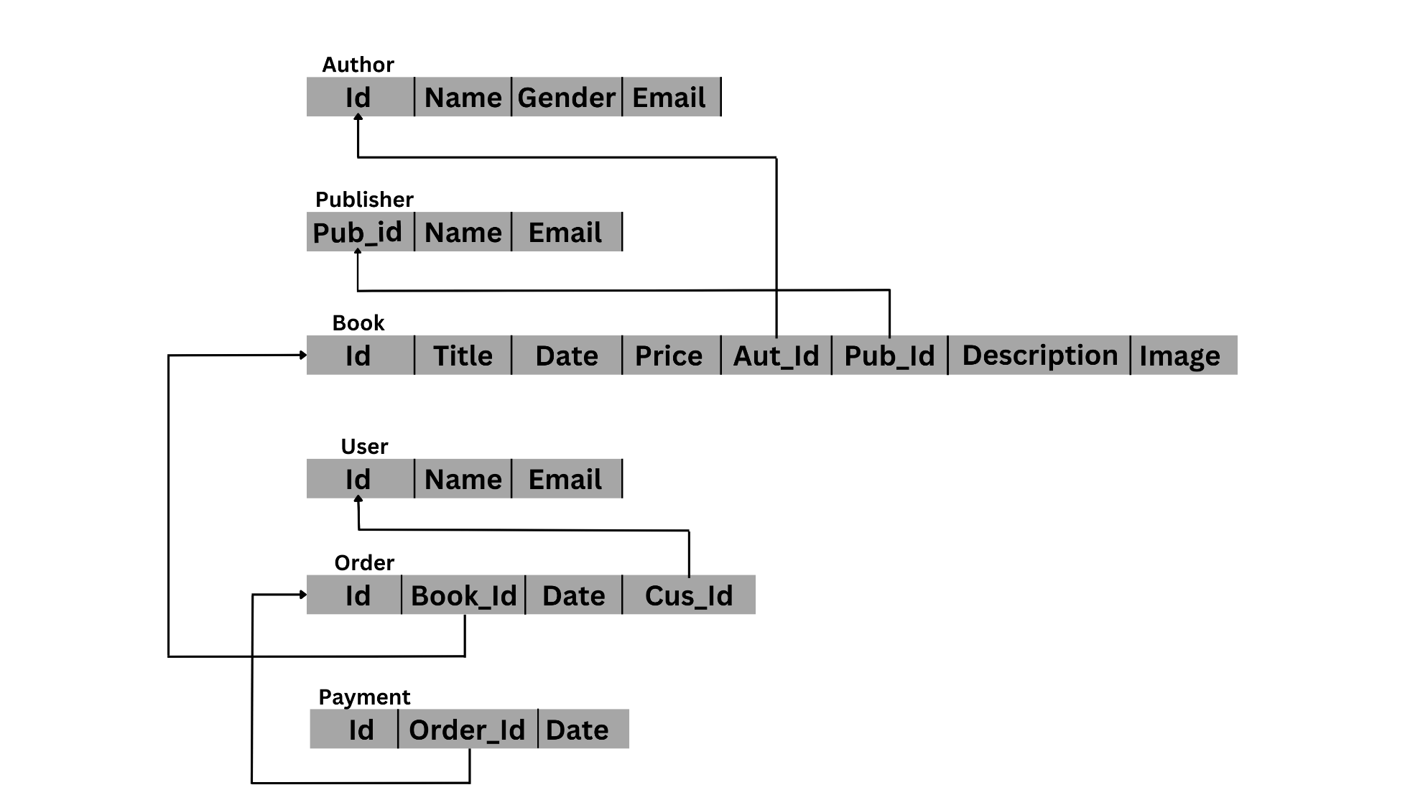
Detailed Design
Schema Diagram

Slide 9
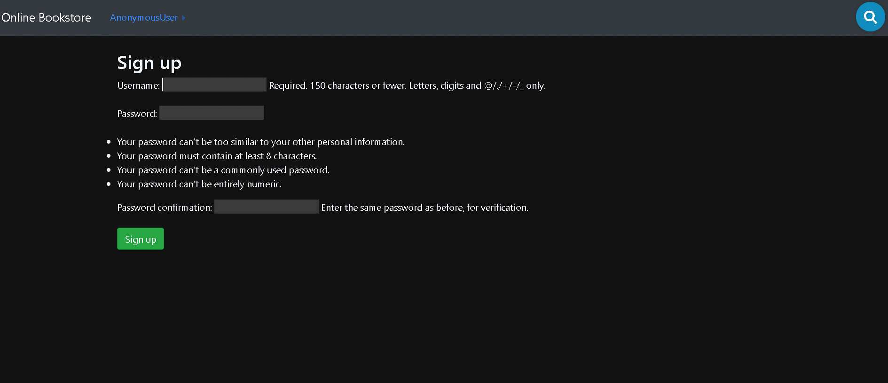
Results / Snapshots / Discussions
USER LOGIN PAGE

Slide 10
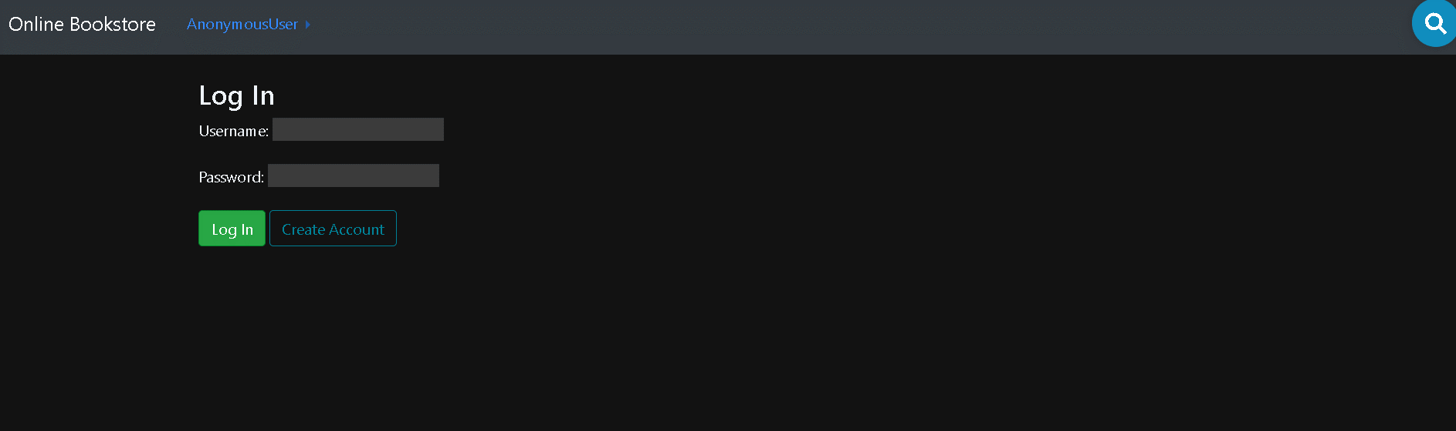
Results / Snapshots / Discussions
LOGIN PAGE

Slide 11
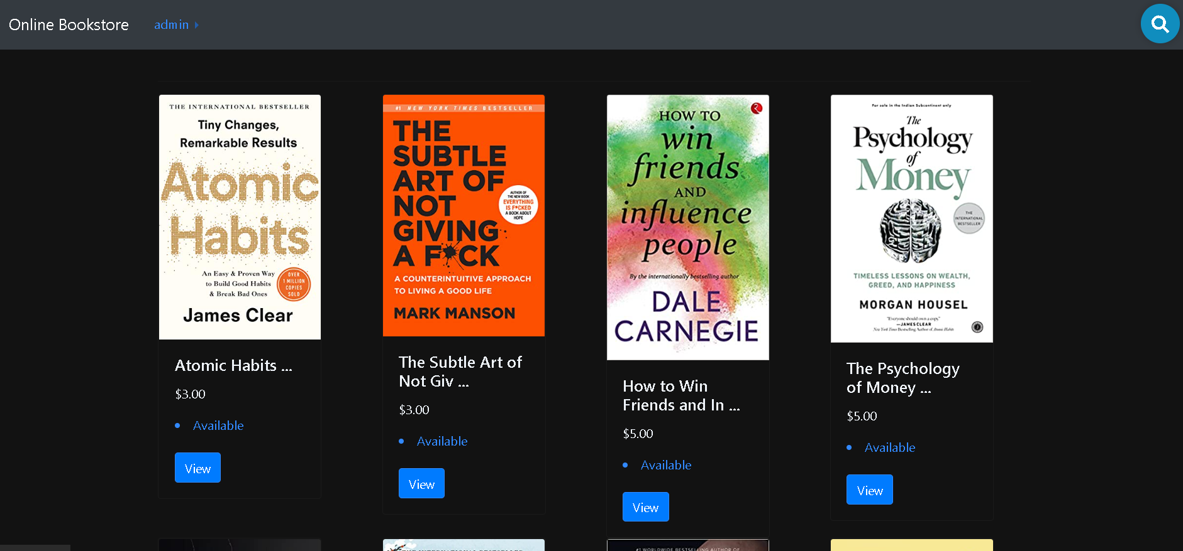
Results / Snapshots / Discussions
HOME PAGE

Slide 12
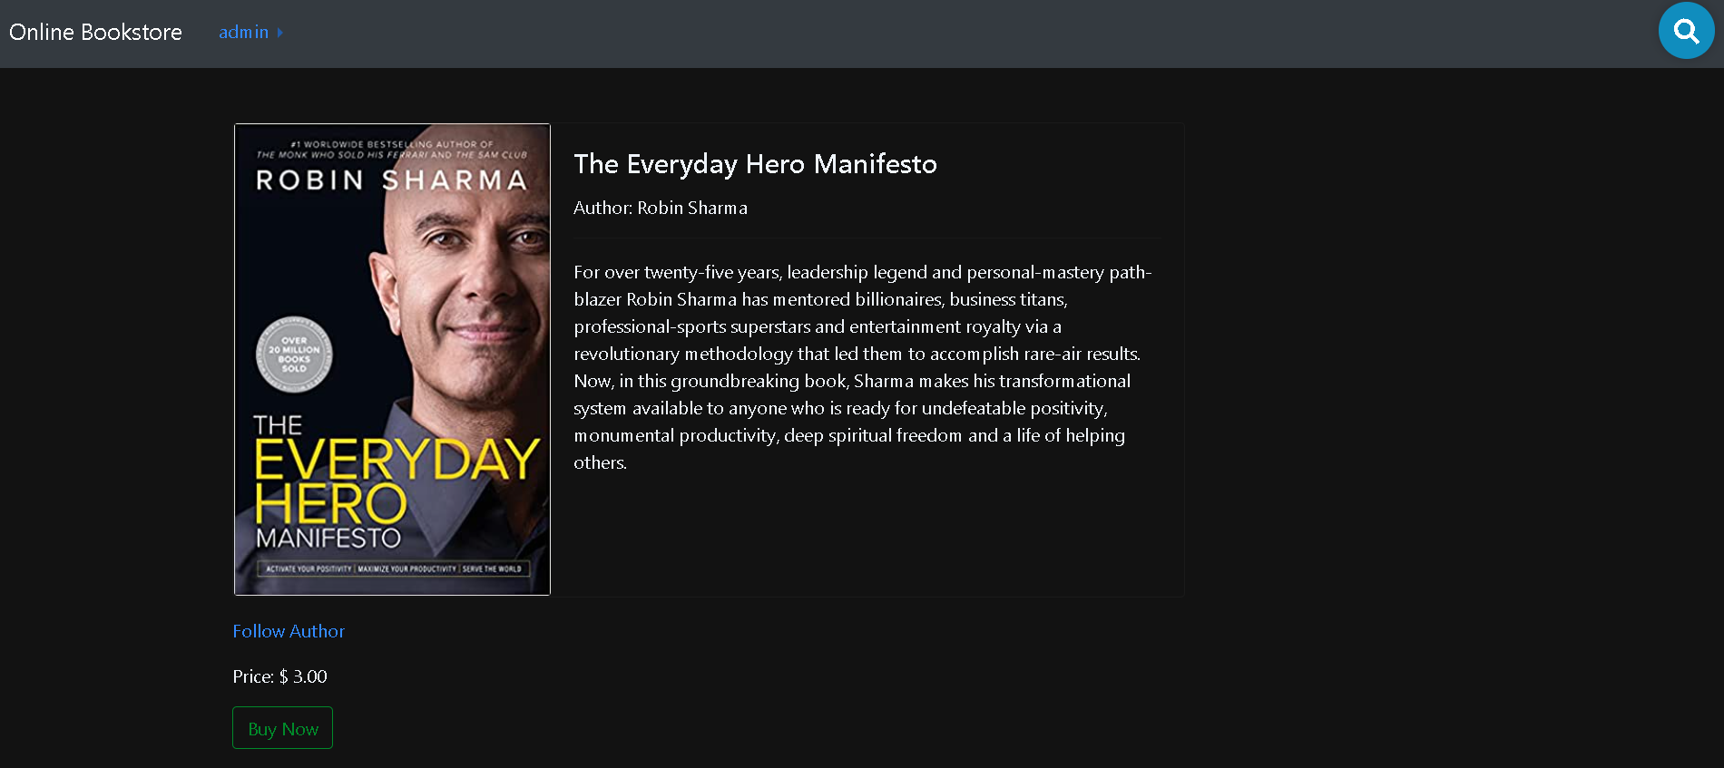
Results / Snapshots / Discussions
BOOK DESCRIPTION PAGE

Slide 13
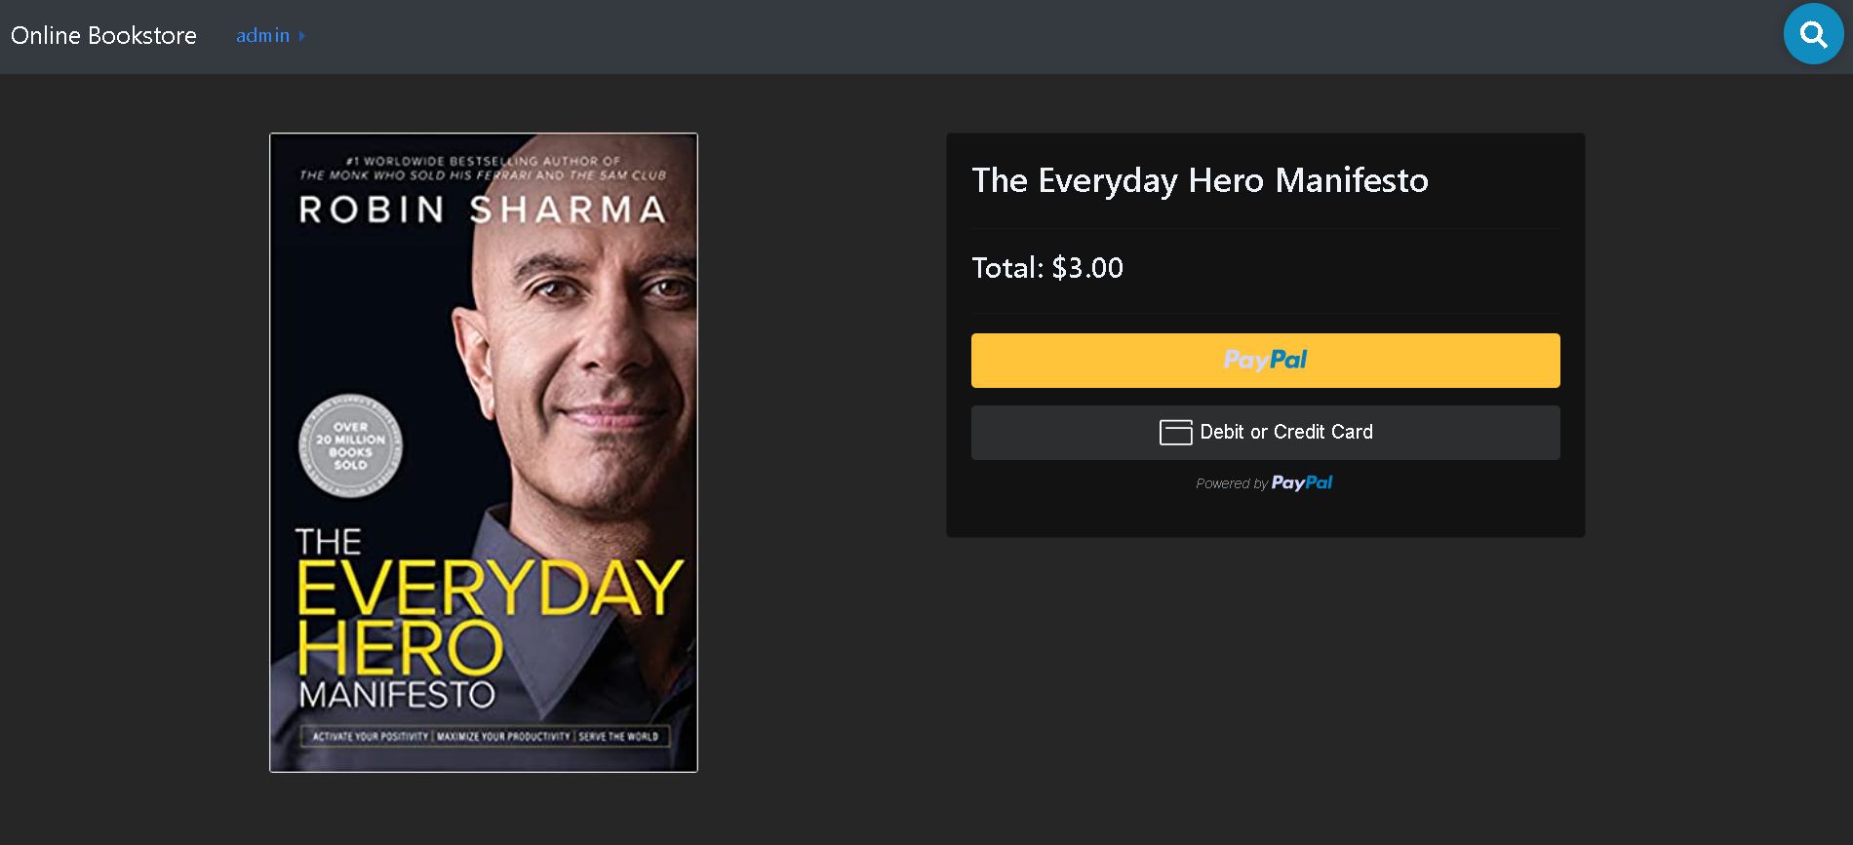
Results / Snapshots / Discussions
CHECKOUT PAGE

Slide 14
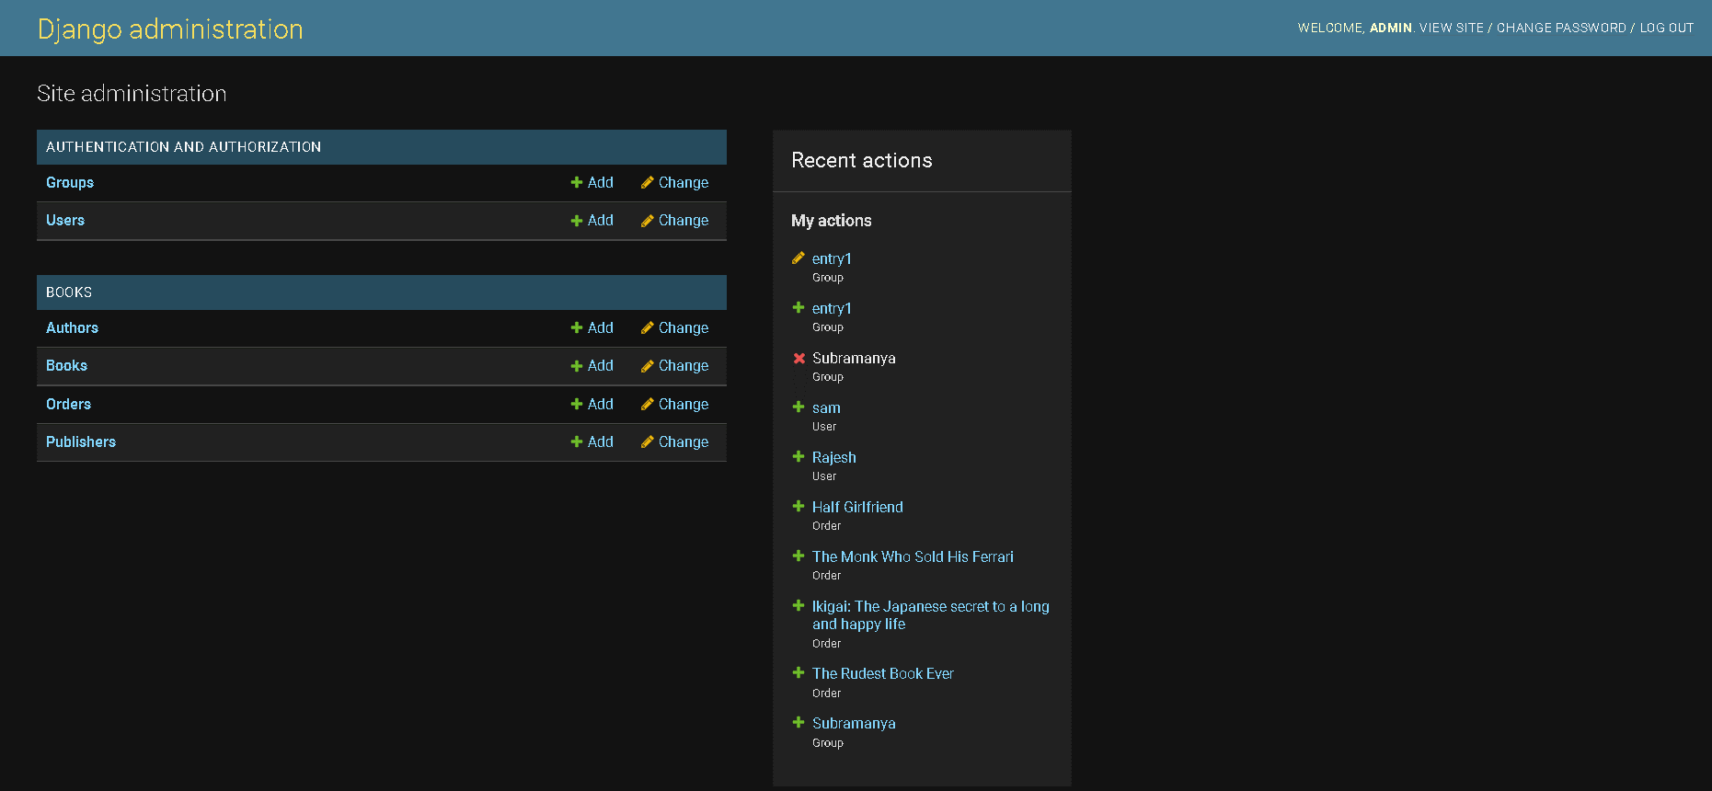
Results / Snapshots / Discussions
ADMIN PANEL

Slide 15
CONCLUSIONS
The switch from written books being from bookstores to being ordered online or even just digital copies has had profound effects on the industry including bookstores and libraries and the general people of the world.
The positives include easy access for everyone and cheaper books along with saving natural resources.
The advantages of implementing the Online book store is to the present systems used by the library.

Slide 16
FUTURE ENHANCEMENTS
Our project is a fairly simple Database consisting of a few fields, adding more information and being able to manage more student information with added functionality.
Further we can also categorize the books based on various Genre's so that user can easily filter out books accordingly.
We can also implement a star based review system for each book so that a user can buy books based on their reviews.
User Interface and User Experience can be further enhanced by using advanced frontend frameworks rather than server-side rendering the templates.
However, there are many scopes to modify this system. Due to shortage of time, we here unable to include many features

Slide 17
REFERENCES
Project Repository – https://github.com/shodhanshetty14/BookStore-Django
The Bootstrap Website (for Design) – https://getbootstrap.com/
W3 Schools (HTML, CSS and PHP reference) –https://www.w3schools.com/html
Database management systems, Ramakrishnan, and Gehrke, 3rd Edition, 2014, McGraw Hill.
Django Official Documentation – https://www.djangoproject.com/
Stack Overflow –https://stackoverflow.com/
Django templates – https://docs.djangoproject.com/en/4.1/ref/templates/api/#django.template.Engine
Paypal Dashboard – https://developer.paypal.com/dashboard/

Slide 18
THANK YOU

